Slide 1
SMA
West Bengal
Social Media Analytics Update
Start Date |  | End Date |  | Duration | 7 Days | Analysed Properties | 105
<Analysis_date>

Slide 2
Table of Contents
Section | Sub-Section | Analysis | Slide No.
Section 1: Overall State Party Summary | Section 1.1: Overall Party Official Pages Summary | Party Official Pages Overview | 7
 |  | Facebook Party Official Pages (7 DMA) | 8
 |  | Twitter Party Official Pages (7 DMA) | 9
 |  | Instagram Party Official Pages (7 DMA) | 10
 |  | YouTube Party Official Pages (7 DMA) | 11
 | Section 1.2: Party Official Pages Comparative Analysis | Facebook Party Official Pages Weekly Performance | 14-15
 |  | Twitter Party Official Pages Weekly Performance | 17-18
 |  | Instagram Party Official Pages Weekly Performance | 20-21
 |  | YouTube Party Official Pages Weekly Performance | 23-24
 | Section 1.3: Party Official Pages Most Engaging Post | Facebook Party Official Pages Most Engaging Post | 26
 |  | Twitter Party Official Pages Most Engaging Post | 27
 |  | Instagram Party Official Pages Most Engaging Post | 28
 |  | YouTube Party Official Pages Most Engaging Post | 29
Section 2: Overall State Leaders Summary | Section 2.1: Overall Top Leaders Pages Summary | Top Leaders Official Pages Overview - Overall | 32
 |  | Top Leaders Official Pages Overview – Last 7 Days | 33
 |  | Facebook Top Leader Official Pages (7 DMA) | 34
 |  | Twitter Top Leader Official Pages (7 DMA) | 35
 |  | Instagram Facebook Top Leader Official Pages (7 DMA) | 36
 |  | YouTube Facebook Top Leader Official Pages (7 DMA) | 37

Slide 3
Table of Contents
Section | Sub-Section | Analysis | Slide No.
Section 2: Overall State Leaders Summary | Section 2.2: Top Leaders Pages Most Engaging Post | Facebook Top Leaders Most Engaging Post | 39
 |  | Twitter Top Leaders Most Engaging Post | 40
 |  | Instagram Top Leaders Most Engaging Post | 41
 |  | YouTube Top Leaders Most Engaging Post | 42
 | Section 2.3: All Leaders Weekly Comparative Analysis | Facebook Followers and Activity Weekly Performance | 45
 |  | Facebook Activity and Views Weekly Performance | 46
 |  | Facebook Engagement Weekly Performance | 47
 |  | Twitter Followers and Activity Weekly Performance | 49
 |  | Twitter Activity and Views Weekly Performance | 50
 |  | Twitter Engagement Weekly Performance | 51
 |  | Twitter Impression Weekly Performance | 52
 |  | Instagram Followers and Activity Weekly Performance | 54
 |  | Instagram Activity and Views Weekly Performance | 55
 |  | Instagram Engagement Weekly Performance | 56
 |  | YouTube Followers and Activity Weekly Performance | 58
 |  | YouTube Activity and Views Weekly Performance | 59
 |  | YouTube Engagement Weekly Performance | 60

Slide 4
Table of Contents
Section | Sub-Section | Analysis | Slide No.
Section 3: Campaign Pages Weekly Comparative Analysis |  | Facebook Followers and Activity Weekly Performance | 63
 |  | Facebook Activity and Views Weekly Performance | 64
 |  | Facebook Engagement Weekly Performance | 65
 |  | Twitter Followers and Activity Weekly Performance | 67
 |  | Twitter Activity and Views Weekly Performance | 68
 |  | Twitter Engagement Weekly Performance | 69
 |  | Twitter Impression Weekly Performance | 70
 |  | Instagram Followers and Activity Weekly Performance | 72
 |  | Instagram Activity and Views Weekly Performance | 73
 |  | Instagram Engagement Weekly Performance | 74
 |  | YouTube Followers and Activity Weekly Performance | 76
 |  | YouTube Activity and Views Weekly Performance | 77
 |  | YouTube Engagement Weekly Performance | 78
Section 4: Annexure |  | Party Details | 80
 |  | Leader Details | 81
 |  | Campaign Details | 82

Slide 8
SMA
Section 1:
State Level-Party Pages Analysis

Slide 9
SMA
Section 1.1:
Party Official Pages-Summary

Slide 10
Party Official Pages Overview
Overall
Party | Facebook |  |  |  | Instagram |  |  |  | Twitter |  |  |  | YouTube
 | Total Follower | Average Post Per Day | Average Engagement | Engagement Rate | Total Follower | Average Post Per Day | Average Engagement | Engagement Rate | Total Follower | Average Post Per Day | Average Engagement | Engagement Rate | Total Follower | Average Video Views | Average Engagement | Engagement Rate
AITC
BJP
INC
CPI(M)
Last 7 Days
Party | Facebook |  |  |  | Instagram |  |  |  | Twitter |  |  |  | YouTube
 | Total Follower | Average Post Per Day | Average Engagement | Engagement Rate | Total Follower | Average Post Per Day | Average Engagement | Engagement Rate | Total Follower | Average Post Per Day | Average Engagement | Engagement Rate | Total Follower | Average Video Views | Average Engagement | Engagement Rate
AITC
BJP
INC
CPI(M)

Slide 11

Party Official Pages (7 DMA)
AVERAGE POST PER DAY
FOLLOWER
AVERAGE ENGAGEMENT
ENGAGEMENT RATE
— AITC — BJP — INC — CPI(M)

Slide 12

Party Official Pages (7 DMA)
AVERAGE POST PER DAY
FOLLOWER
AVERAGE ENGAGEMENT
ENGAGEMENT RATE
— AITC — BJP — INC — CPI(M)

Slide 13

Party Official Pages (7 DMA)
AVERAGE POST PER DAY
FOLLOWER
AVERAGE ENGAGEMENT
ENGAGEMENT RATE
— AITC — BJP — INC — CPI(M)

Slide 14

Party Official Pages (7 DMA)
AVERAGE POST PER DAY
FOLLOWER
AVERAGE ENGAGEMENT
ENGAGEMENT RATE
— AITC — BJP — INC — CPI(M)

Slide 15
SMA
Section 1.2:
Party Official Pages-Comparative Weekly Performance

Slide 16
SMA
Facebook (All Parties)

Slide 17
Party Official Pages Weekly Performance
Total Follower
Count of Active Days
Total Post
Avg. Post Per Days
Type of Post
Last 7 Days
Changes
Link Photo Status Video
- No activity in previous week
- No activity in current week

Slide 18
Party Official Pages Weekly Performance
Total Engagement
Avg. Engagement
Engagement Rate
Avg. Video Views
Last 7 Days
Changes
- No activity in previous week
- No activity in current week

Slide 19
SMA
Twitter (All Parties)

Slide 20
Party Official Pages Weekly Performance
Total Follower
Count of Active Days
Total Post
Avg. Post Per Days
Type of Post
Last 7 Days
Changes
Link Photo Status Video
- No activity in previous week
- No activity in current week

Slide 21
Party Official Pages Weekly Performance
Total Engagement
Avg. Engagement
Engagement Rate
Avg. Video Views
Avg. Impressions
Last 7 Days
Changes
- No activity in previous week
- No activity in current week

Slide 22
SMA
Instagram (All Parties)

Slide 23
Party Official Pages Weekly Performance
Total Follower
Count of Active Days
Total Post
Avg. Post Per Days
Type of Post
Last 7 Days
Changes
Carousel Photo Reel
- No activity in previous week
- No activity in current week

Slide 24
Party Official Pages Weekly Performance
Total Engagement
Avg. Engagement
Engagement Rate
Last 7 Days
Changes
- No activity in previous week
- No activity in current week

Slide 25
SMA
YouTube (All Parties)

Slide 26
Party Official Pages Weekly Performance
Total Follower
Count of Active Days
Total Post
Avg. Post Per Days
Last 7 Days
Changes
- No activity in previous week
- No activity in current week

Slide 27
Party Official Pages Weekly Performance
Total Engagement
Avg. Engagement
Engagement Rate
Total Video Views
Avg. Video Views
Last 7 Days
Changes

Slide 28
SMA
Section 1.3:
Party Official Pages Most Engaging Post

Slide 29
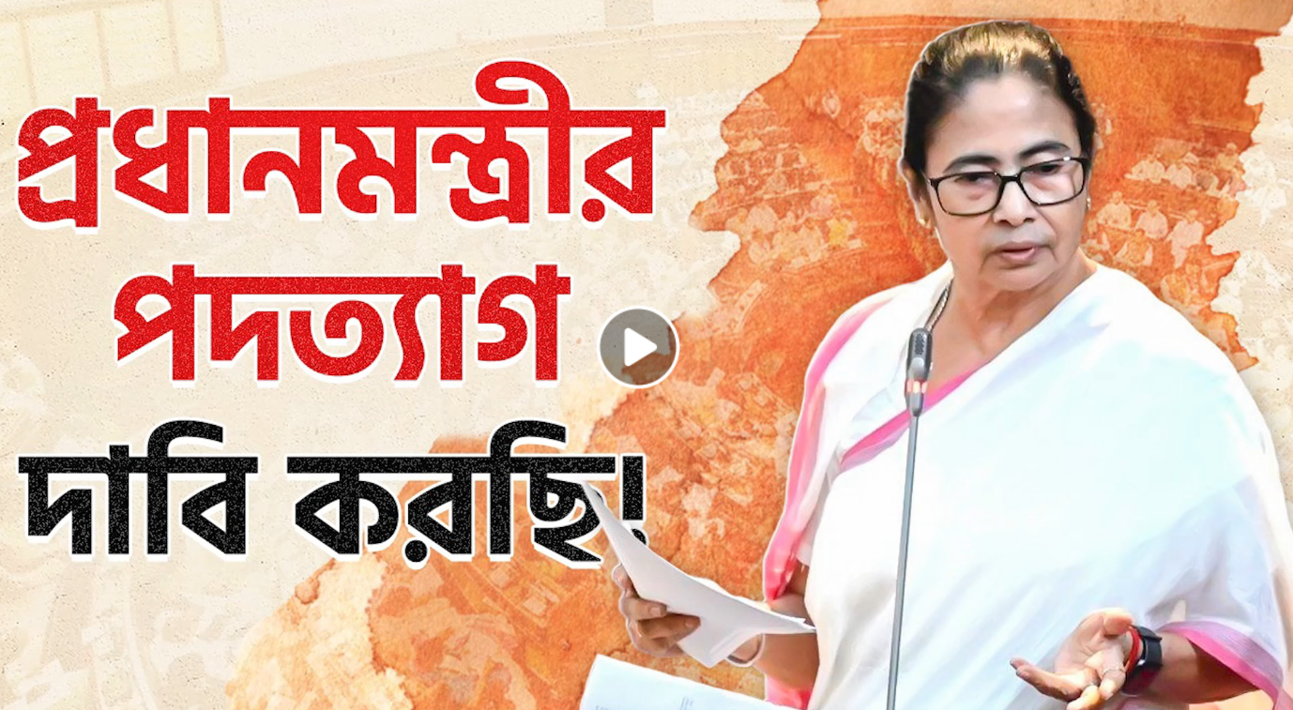
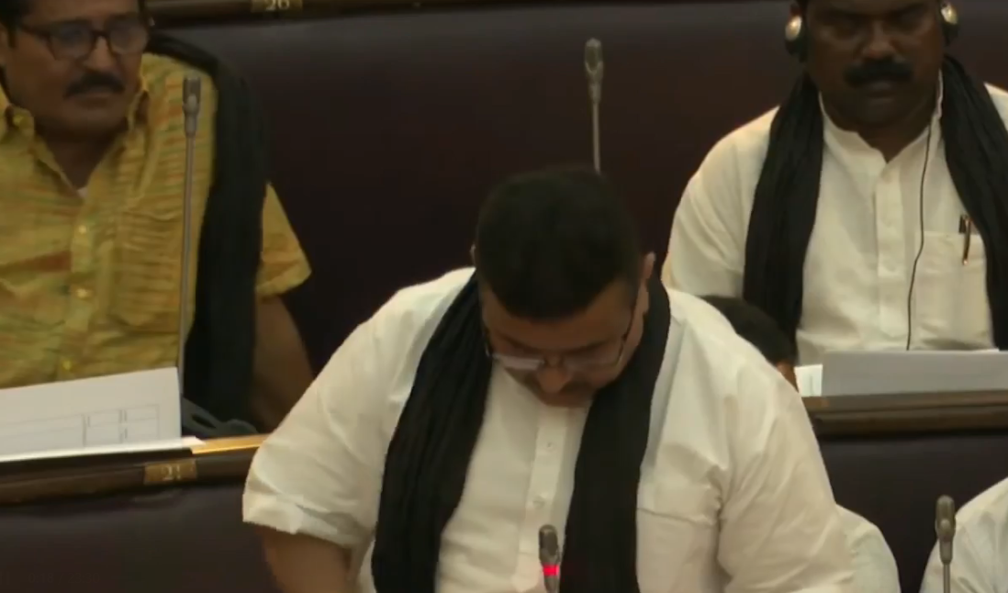
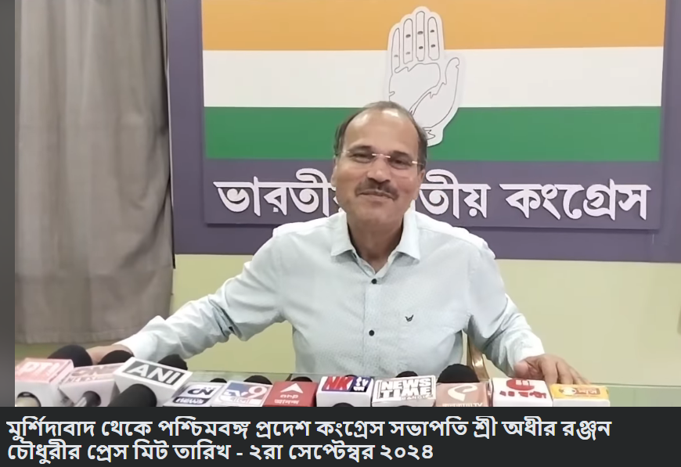
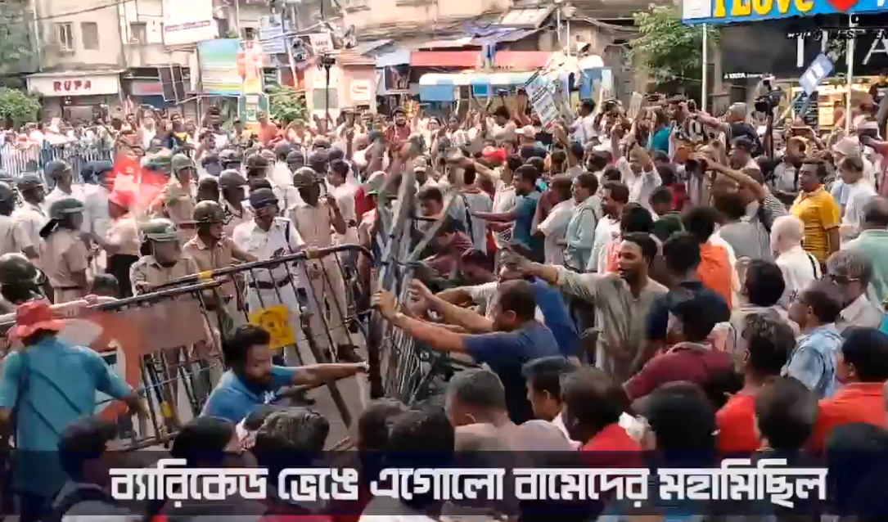

SMA
Party Official Pages Most Engaging Post
AITC
BJP
INC
CPI(M)
23.4K 608 3.7K 65 29 282
5.7K 1.2K 28 5 3 2
490 21 3 0 0 1
3K 1.1K 6 6 0 1
Video: "May women's power prevail, and may the undefeated receive justice. To combat rape, the 'Oparajita Nari O Shishu' (West Bengal Criminal Law Amendment Bill, 2024) will become a model across the country.“ #BengalShowsTheWay
Live Video
Video: Press meeting of Shri Adhir Ranjan Chowdhury, President of West Bengal Pradesh Congress from Murshidabad
Live Video
Engagement: 33,384
Likes: 28,083
Comments: 3,015
Shares: 2,286
Engagement: 9,350
Likes: 6,888
Comments: 1,185
Shares: 1,277
Engagement: 589
Likes: 515
Comments: 18
Shares: 56
Engagement: 6,662
Likes: 4,135
Comments: 603
Shares: 1,924
Link: https://www.facebook.com/527851522045630/videos/2517039611813344
Link: https://www.facebook.com/558659898955822/videos/534246705749051
Link: https://www.facebook.com/416209120551655/videos/1971653976611960
Link: https://www.facebook.com/555270622626045/videos/1221958968987859

Slide 30
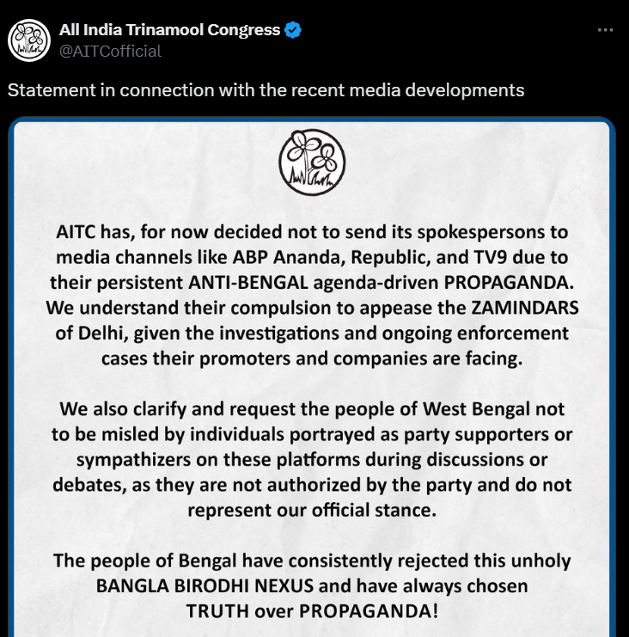
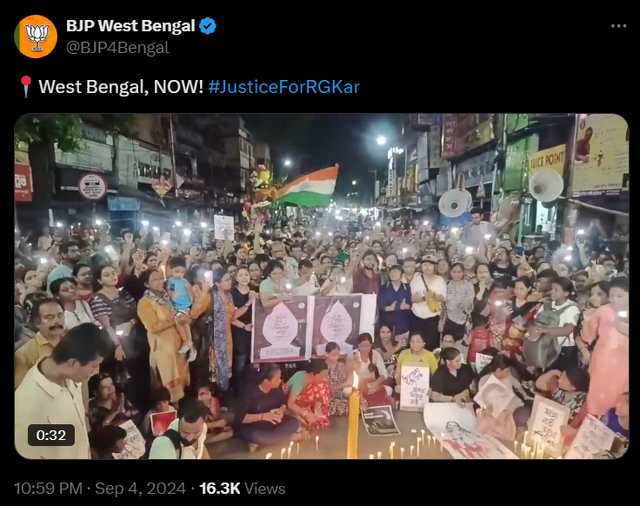
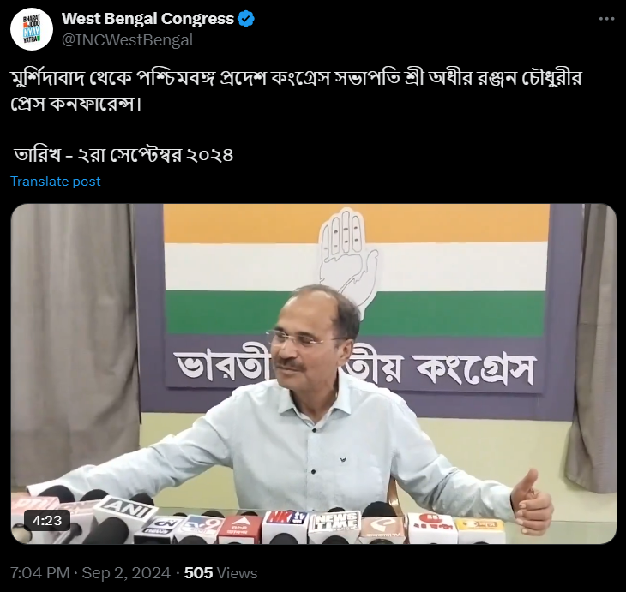
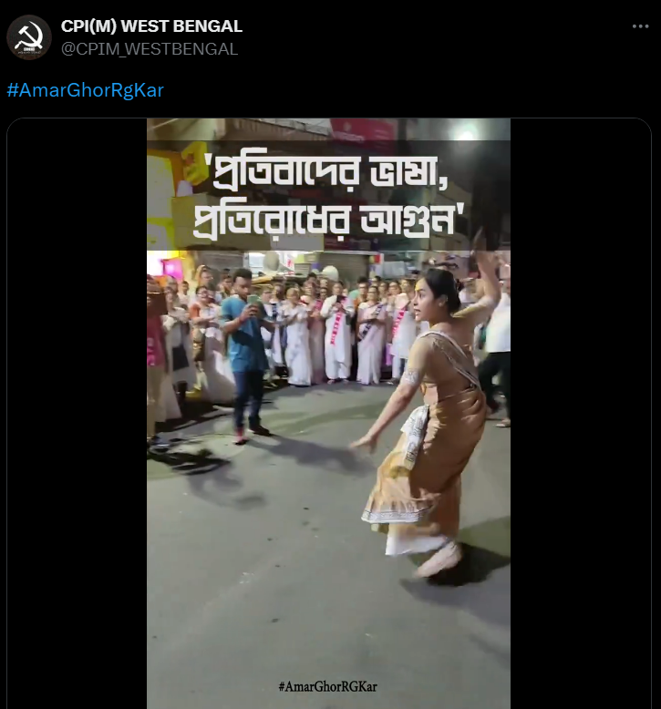
Party Official Pages Most Engaging Post
AITC
BJP
INC
CPI(M)
Photo: Statement in connection with the recent media developments
Photo: "📍West Bengal, NOW! #JusticeForRGKar
Video: Press conference of Shri Adhir Ranjan Chowdhury, President of West Bengal Pradesh Congress from Murshidabad
Photo: #AmarGhorRgKar
Engagement: 4,117
Likes: 2,152
Comments: 1,020
Shares: 945
Engagement: 2,618
Likes: 2,186
Comments: 400
Shares: 32
Engagement: 56
Likes: 45
Comments: 10
Shares: 1
Engagement: 1,476
Likes: 1,140
Comments: 196
Shares: 140
Link: https://twitter.com/AITCofficial/status/1830265678357844305
Link: https://twitter.com/BJP4Bengal/status/1831384215843434571
Link: https://twitter.com/INCWestBengal/status/1830600065658097796
Link: https://twitter.com/CPIM_WESTBENGAL/status/1830139037807423798

Slide 31
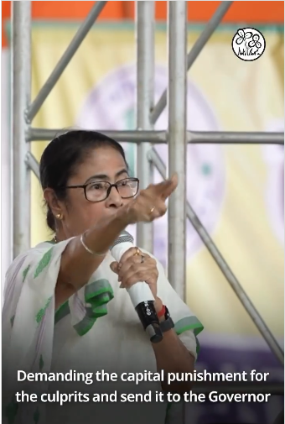
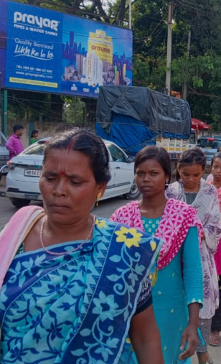
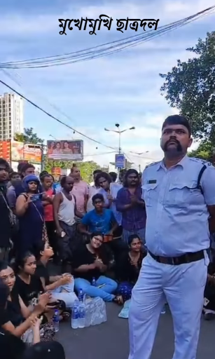
SMA
Party Official Pages Most Engaging Post
AITC
BJP
INC
CPI(M)
No Post
Reel: "This fight will not stop, we will not accept defeat... Birbhum BJP stands firm against violence against women.“
#ResignMamata
#MamataMustResign #JusticeforRGKar
#WeWantJustice
#JusticeForRGKar
Reel: "Students of Rabindra Bharati University sang for the police."
Reel: Actions speak louder than words! The Anti-Rape Bill is a landmark step towards ensuring that our women are protected at all costs. This Bill is about enacting real, transformative change. #BengalShowsTheWay
Engagement: 2,671
Likes: 2,574
Comments: 97
Engagement: 3,572
Likes: 3,557
Comments: 15
Engagement: 12,306
Likes: 11,420
Comments: 886
Link: https://www.instagram.com/reel/C_cmkfPPH0C/
Link: https://www.instagram.com/reel/C_as72JqCCj/
Link: https://www.instagram.com/reel/C_YBCZsvIyP/

Slide 32
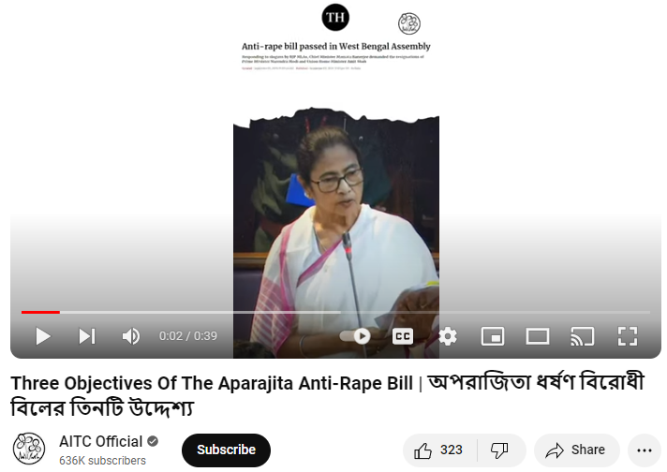
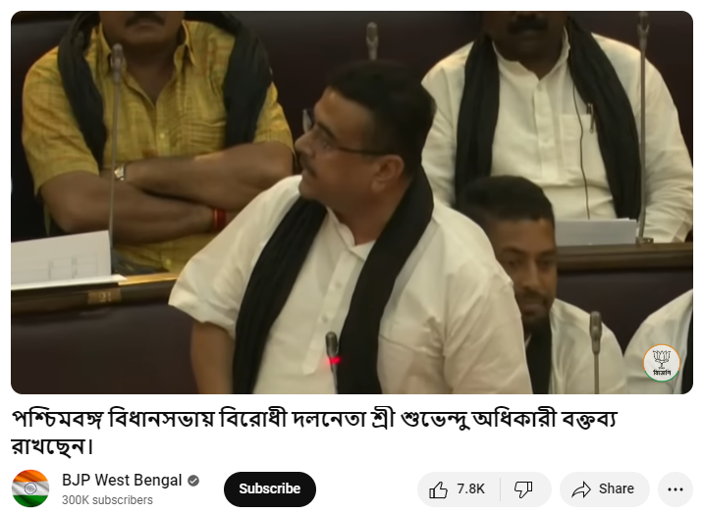
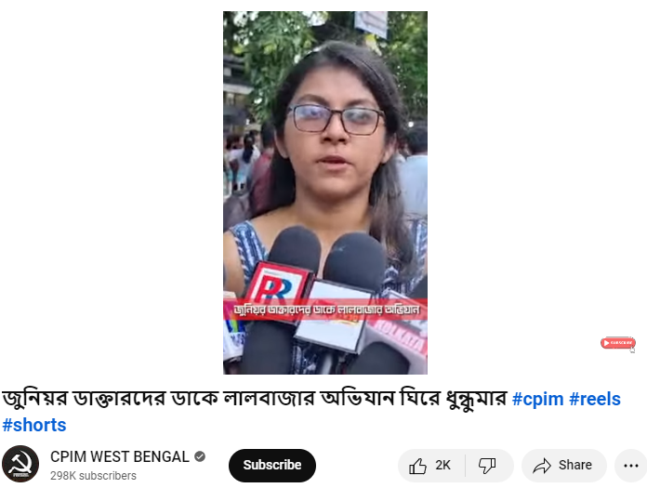
Party Official Pages Most Engaging Post
AITC
BJP
INC
CPI(M)
No Account
Three Objectives Of The Aparajita Anti-Rape Bill |
অপরাজিতা ধর্ষণ বিরোধী বিলের তিনটি উদ্দেশ্য
Leader of the Opposition Shri Suvendu Adhikari is delivering a speech in the West Bengal Legislative Assembly.
Chaos surrounding the Lalbazar raid in response to the call of junior doctors #cpim
Engagement: 286
Likes: 280
Comments: 6
Views: 4,720
Engagement: 8,951
Likes: 7,717
Comments: 1,234
Views: 2,32,807
Engagement: 2066
Likes: 2,045
Comments:21
Views: 47,392
Link: https://www.youtube.com/watch?v=2G5TBgMIq68
Link: https://www.youtube.com/watch?v=fTjUC2mwzj8
Link:
https://www.youtube.com/watch?v=Pq35z-zEES0

Slide 33
SMA
Section 2:
Leaders Analysis

Slide 34
SMA
Section 2.1:
Top Leaders Pages Summary

Slide 35
Top Leaders Official Pages Overview - Overall
Overall
Party | Leaders | Facebook |  |  |  | Instagram |  |  |  | Twitter |  |  |  | YouTube
 |  | Total Follower | Avg. Post Per Day | Average Engagement | Engagement Rate | Total Follower | Average Post Per Day | Average Engagement | Engagement Rate | Total Follower | Average Post Per Day | Average Engagement | Engagement Rate | Total Follower | Average Video Views | Average Engagement | Engagement Rate
AITC | Mamata Banerjee
 | Abhishek Banerjee
BJP | Dilip Ghosh
 | Suvendu Adhikari
INC | Adhir Ranjan Chowdhury
CPI(M) | Sujan Chakraborty
 | Md. Salim

Slide 36
Top Leaders Official Pages Overview – Last 7 Days
Last 7 Days
Party | Leaders | Facebook |  |  |  | Instagram |  |  |  | Twitter |  |  |  | YouTube
 |  | Total Follower | Avg. Post Per Day | Average Engagement | Engagement Rate | Total Follower | Average Post Per Day | Average Engagement | Engagement Rate | Total Follower | Average Post Per Day | Average Engagement | Engagement Rate | Total Follower | Average Video Views | Average Engagement | Engagement Rate
AITC | Mamata Banerjee
 | Abhishek Banerjee
BJP | Dilip Ghosh
 | Suvendu Adhikari
INC | Adhir Ranjan Chowdhury
CPI(M) | Sujan Chakraborty
 | Md. Salim

Slide 37
Top Leader Official Pages (7 DMA)
AVERAGE POST PER DAY
FOLLOWER
AVERAGE ENGAGEMENT
ENGAGEMENT RATE
— Mamata Banerjee — Abhishek Banerjee — Suvendu Adhikari — Dilip Ghosh — Adhir Ranjan Chowdhury — Md. Salim — Sujan Chakraborty

Slide 38
Top Leader Official Pages (7 DMA)
AVERAGE POST PER DAY
FOLOWER
AVERAGE ENGAGEMENT
ENGAGEMENT RATE
— Mamata Banerjee — Abhishek Banerjee — Suvendu Adhikari — Dilip Ghosh — Adhir Ranjan Chowdhury — Md. Salim — Sujan Chakraborty

Slide 39
Top Leader Official Pages (7 DMA)
AVERAGE POST PER DAY
FOLLOWER
AVERAGE ENGAGEMENT
ENGAGEMENT RATE
— Mamata Banerjee — Abhishek Banerjee — Suvendu Adhikari — Dilip Ghosh — Adhir Ranjan Chowdhury — Md. Salim — Sujan Chakraborty

Slide 40
Top Leader Official Pages (7 DMA)
AVERAGE POST PER DAY
FOLLOWER
AVERAGE ENGAGEMENT
ENGAGEMENT RATE
— Mamata Banerjee — Abhishek Banerjee — Suvendu Adhikari — Dilip Ghosh — Adhir Ranjan Chowdhury — Md. Salim — Sujan Chakraborty

Slide 41
SMA
Section 2.2:
Top Leaders Pages Most Engaging Post

Slide 42
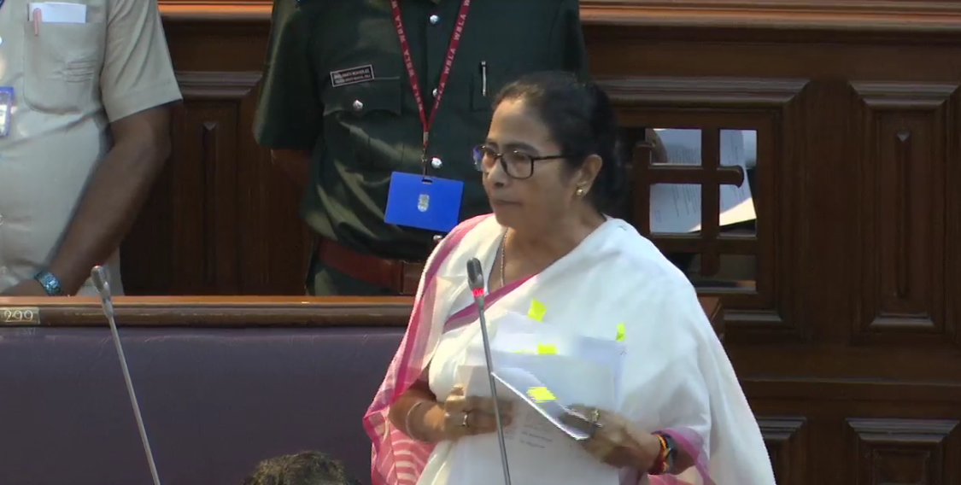
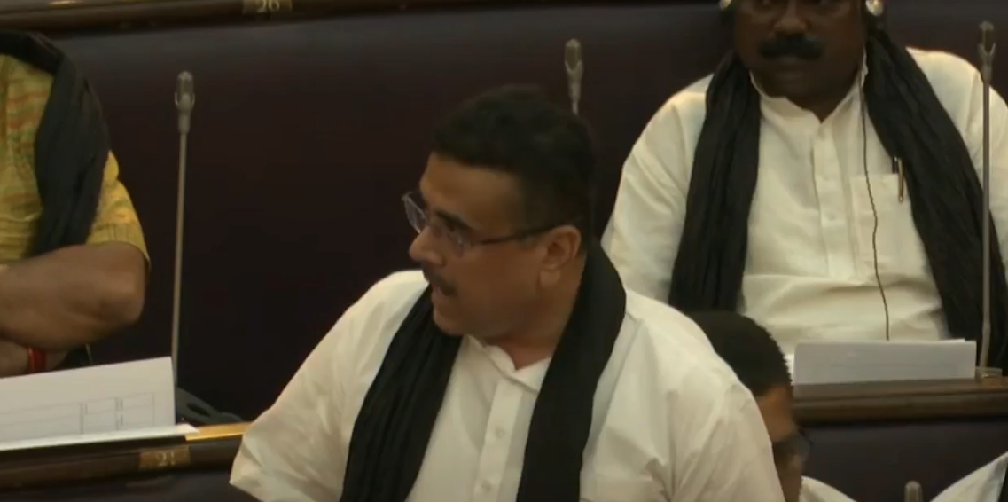
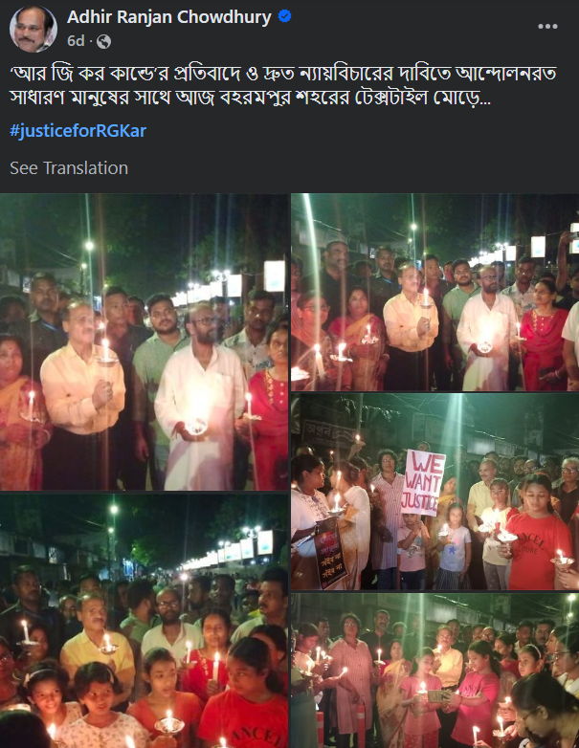
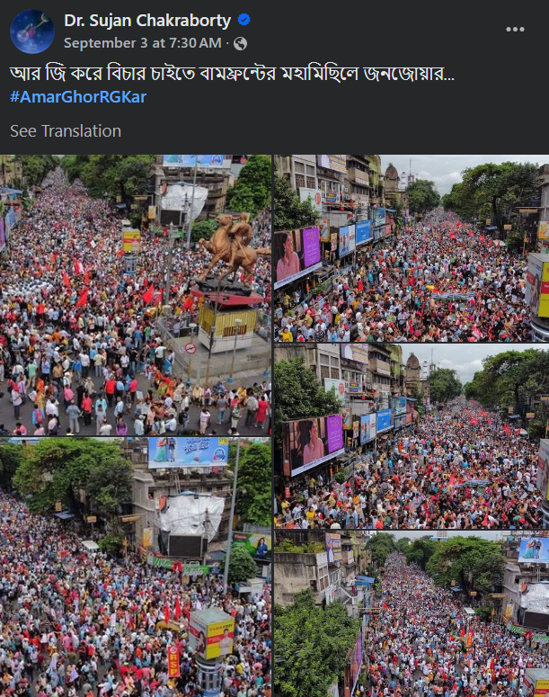
Top leaders Most Engaging Post (Last 7 Days)
Mamata Banerjee
Suvendu Adhikari
Adhir Ranjan Chowdhury
Sujan Chakraborty
10.7K 5.9K 493 28 11 58
13.4K 4.3K 106 26 9 4
564 82 0 1 0 0
805 194 2 1 0 0
Video: Presenting the Anti-Rape Bill in the West Bengal State Assembly
Video: West Bengal Legislative Assembly
Photo: Today at the textile junction of Bahrampur city with the general people protesting against 'RG Kande' and demanding quick justice.... #justiceforRGKar
Photo: The crowd in the Left Front's grand festival demanding justice by RG...#AmarGhorRGKar
Engagement: 35,722
Likes: 17,128
Comments: 9,695
Shares: 8,899
Engagement: 25,912
Likes: 17,868
Comments: 4,480
Shares: 3,564
Engagement: 718
Likes: 647
Comments: 37
Shares: 34
Engagement: 1,104
Likes: 1,002
Comments: 43
Shares: 59
Link: https://www.facebook.com/534507618044969/videos/1056449849529787
Link: https://www.facebook.com/547286240089663/videos/1430511170973397
Link: https://www.facebook.com/534554428041045/posts/1048231533339996
Link: https://www.facebook.com/262794758540611/posts/1070989271054485

Slide 43
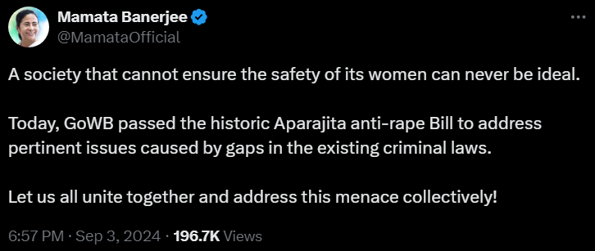
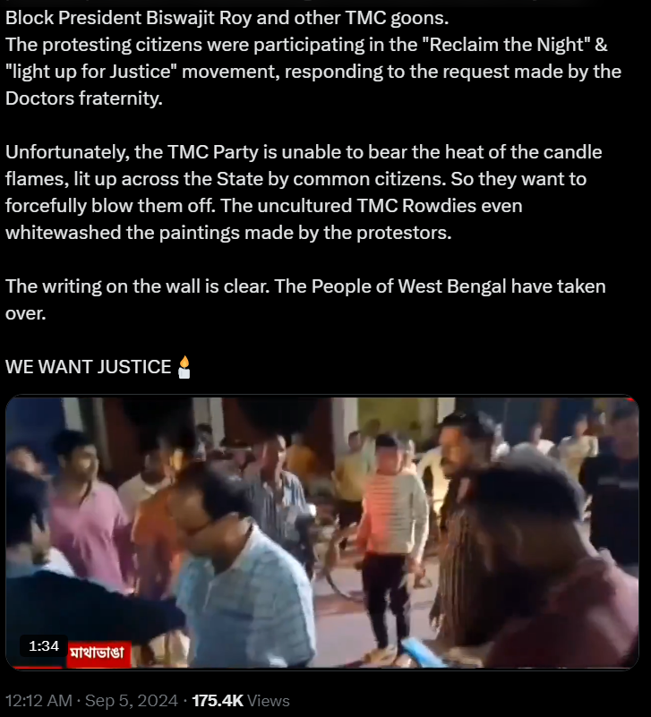
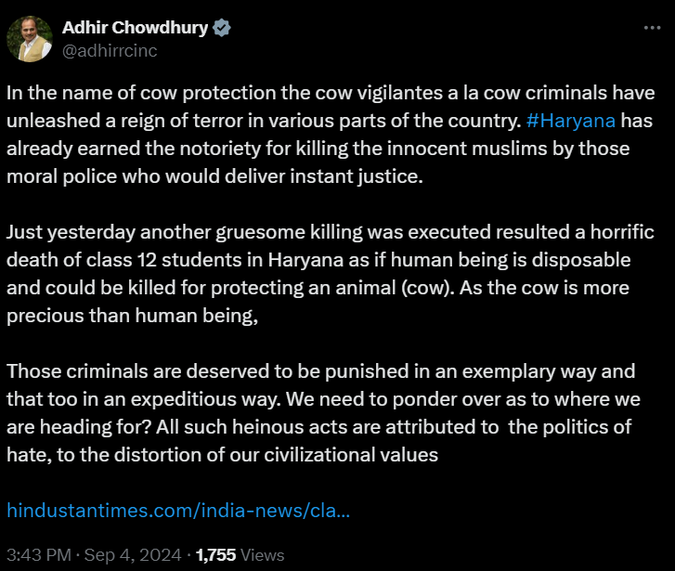
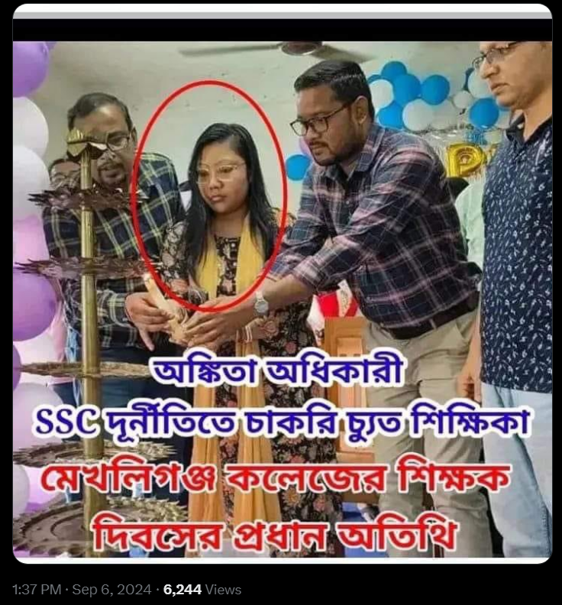
Top leaders Most Engaging Post (Last 7 Days)
Mamata Banerjee
Suvendu Adhikari
Adhir Ranjan Chowdhury
Sujan Chakraborty
Photo: Corruption in teacher recruitment
As the crime is proven Ankita Adhikari lost her job.
Trinamool education minister's daughter. Isn't it a shame?
That criminal is Ankita Trinamool district leader of Cooch Behar now!
Mekhliganj College Teacher's Day chief guest!
This is the root. Where is the place to keep so much shame!
Shit: !!
Engagement: 7,074
Likes: 4,410
Retweets: 1,477
Replies: 1,187
Engagement: 12,310
Likes: 8,390
Retweets: 3,382
Replies: 538
Engagement: 115
Likes: 87
Retweets: 25
Replies: 3
Engagement: 382
Likes: 276
Retweets: 75
Replies: 31
Link: https://twitter.com/MamataOfficial/status/1830960815530237961
Link: https://twitter.com/SuvenduWB/status/1831402411644350676
Link: https://twitter.com/adhirrcinc/status/1831274473770868810
Link: https://twitter.com/sujan_speak/status/1831967449308393582

Slide 44
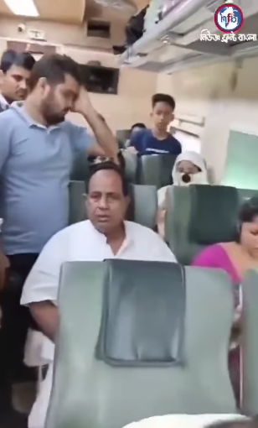
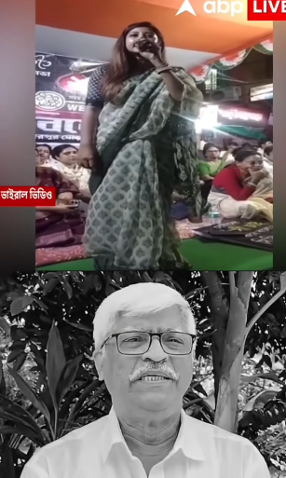
Top leaders Most Engaging Post (Last 7 Days)
Mamata Banerjee
Suvendu Adhikari
Adhir Ranjan Chowdhury
Sujan Chakraborty
No Post
No Account
Reel: Public awareness in West Bengal 🙏The people of Bengal will no longer tolerate Trinamuli corruption, oppression, injustice, eye-catching faces. There will be a protest. Two of them were touring the Intercity Express with Nabagram's Trinamool MLA Kanai Chandra Mandal, which one of whom had the ticket, was not his own. The legislator kept abusing the train ticket inspector questioning it. Passengers are extremely annoyed and strongly protested by the behavior of the MLA. Remind him that he is not above the law because he is an MLA.
Reel: Be careful how people whisper
Engagement: 2,851
Likes: 2,788
Comments: 63
Engagement: 735
Likes: 713
Comments: 22
Link: https://www.instagram.com/reel/C_cXxCfPU_a
Link: https://www.instagram.com/reel/C_aZg9LNeSD

Slide 45
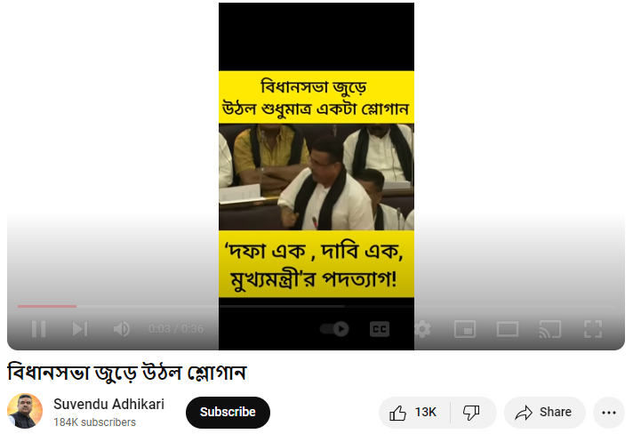
Top leaders Most Engaging Post (Last 7 Days)
Mamata Banerjee
Suvendu Adhikari
Adhir Ranjan Chowdhury
Sujan Chakraborty
No Post
No Account
No Post
Slogans echoed throughout the Assembly
Engagement: 13,315
Likes: 13,008
Comments: 307
Views: 2,94,495
Link:
https://www.youtube.com/watch?v=-5g7FKvxnj8

Slide 46
SMA
Section 2.3:
All Leaders Weekly Comparative Analysis

Slide 47
SMA
Facebook (All Leaders)

Slide 48
Followers and Activity Weekly Performance
Total Follower
Follower Growth
Count of Active Days
Active Days Growth
Total Post
Total Post Growth
- No activity in previous week
- No activity in current week

Slide 49
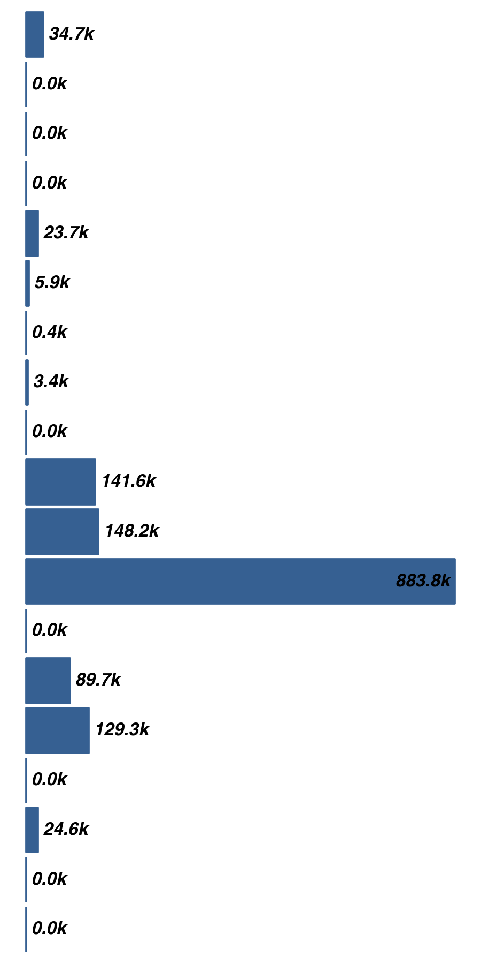
Activity and Views Weekly Performance
Avg. Post Per Day
Avg. Post Per Day Growth
Type of Post
Avg. Video Views
Avg. Video Views Growth
Link Photo Status Video
- No activity in previous week
- No activity in current week

Slide 50
Engagement Weekly Performance
Total Engagement
Engagement Growth
Avg. Engagement
Avg. Engagement Growth
Engagement Rate
Engagement Rate Growth
- No activity in previous week
- No activity in current week

Slide 51
SMA
Twitter (All Leaders)

Slide 52
Followers and Activity Weekly Performance
Total Follower
Follower Growth
Count of Active Days
Active Days Growth
Total Post
Total Post Growth
- No activity in previous week
- No activity in current week

Slide 53
Activity and Views Weekly Performance
Avg. Post Per Day
Avg. Post Per Day Growth
Type of Post
Avg. Video Views
Avg. Video Views Growth
Link Photo Status Video
- No activity in previous week
- No activity in current week

Slide 54
Engagement Weekly Performance
Total Engagement
Engagement Growth
Avg. Engagement
Avg. Engagement Growth
Engagement Rate
Engagement Rate Growth
- No activity in previous week
- No activity in current week

Slide 55
Impression Weekly Performance
Avg. Impression
Avg. Impression Growth
- No activity in previous week
- No activity in current week

Slide 56
SMA
Instagram (All Leaders)

Slide 57
Followers and Activity Weekly Performance
Total Follower
Follower Growth
Count of Active Days
Active Days Growth
Total Post
Total Post Growth
- No activity in previous week
- No activity in current week

Slide 58
Activity Weekly Performance
Avg. Post Per Day
Avg. Post Per Day Growth
Type of Post
Avg. Video Views
Avg. Video Views Growth
Carousel Photo Reel
- No activity in previous week
- No activity in current week

Slide 59
Engagement Weekly Performance
Total Engagement
Engagement Growth
Avg. Engagement
Avg. Engagement Growth
Engagement Rate
Engagement Rate Growth
- No activity in previous week
- No activity in current week

Slide 60
SMA
YouTube (All Leaders)

Slide 61
Followers and Activity Weekly Performance
Total Follower
Follower Growth
Count of Active Days
Active Days Growth
Total Post
Total Post Growth
- No activity in previous week
- No activity in current week

Slide 62
Activity and Views Weekly Performance
Avg. Post Per Day
Avg. Post Per Day Growth
Total Video Views
Video Views Growth
Avg. Video Views
Avg. Video Views Growth
- No activity in previous week
- No activity in current week

Slide 63
Engagement Weekly Performance
Total Engagement
Engagement Growth
Avg. Engagement
Avg. Engagement Growth
Engagement Rate
Engagement Rate Growth
- No activity in previous week
- No activity in current week

Slide 64
SMA
Section 3:
Campaign Pages Weekly Comparative Analysis

Slide 65
SMA
Facebook (Campaign Pages )

Slide 66
Followers and Activity Weekly Performance
Total Follower
Follower Growth
Count of Active Days
Active Days Growth
Total Post
Total Post Growth
- No activity in previous week
- No activity in current week

Slide 67
Activity and Views Weekly Performance
Avg. Post Per Day
Avg. Post Per Day Growth
Type of Post
Avg. Video Views
Avg. Video Views Growth
Video Status Photo
- No activity in previous week
- No activity in current week

Slide 68
Engagement Weekly Performance
Total Engagement
Engagement Growth
Avg. Engagement
Avg. Engagement Growth
Engagement Rate
Engagement Rate Growth
- No activity in previous week
- No activity in current week

Slide 69
SMA
Twitter (Campaign Pages )

Slide 70
Followers and Activity Weekly Performance
Total Follower
Follower Growth
Count of Active Days
Active Days Growth
Total Post
Total Post Growth
- No activity in previous week
- No activity in current week

Slide 71
Activity and Views Weekly Performance
Avg. Post Per Day
Avg. Post Per Day Growth
Type of Post
Avg. Video Views
Avg. Video Views Growth
Video Status Photo
- No activity in previous week
- No activity in current week

Slide 72
Engagement Weekly Performance
Total Engagement
Engagement Growth
Avg. Engagement
Avg. Engagement Growth
Engagement Rate
Engagement Rate Growth
- No activity in previous week
- No activity in current week

Slide 73
Impression Weekly Performance
Avg. Impression
Avg. Impression Growth
- No activity in previous week
- No activity in current week

Slide 74
SMA
Instagram (Campaign Pages )

Slide 75
Followers and Activity Weekly Performance
Total Follower
Follower Growth
Count of Active Days
Active Days Growth
Total Post
Total Post Growth
- No activity in previous week
- No activity in current week

Slide 76
Activity Weekly Performance
Avg. Post Per Day
Avg. Post Per Day Growth
Type of Post
Avg. Video Views
Avg. Video Views Growth
Carousel Photo Reel
- No activity in previous week
- No activity in current week

Slide 77
Engagement Weekly Performance
Total Engagement
Engagement Growth
Avg. Engagement
Avg. Engagement Growth
Engagement Rate
Engagement Rate Growth
- No activity in previous week
- No activity in current week

Slide 78
SMA
YouTube (Campaign Pages )

Slide 79
Followers and Activity Weekly Performance
Total Follower
Follower Growth
Count of Active Days
Active Days Growth
Total Post
Total Post Growth
- No activity in previous week
- No activity in current week

Slide 80
Activity and Views Weekly Performance
Avg. Post Per Day
Avg. Post Per Day Growth
Total Video Views
Video Views Growth
Avg. Video Views
Avg. Video Views Growth
- No activity in previous week
- No activity in current week

Slide 81
Engagement Weekly Performance
Total Engagement
Engagement Growth
Avg. Engagement
Avg. Engagement Growth
Engagement Rate
Engagement Rate Growth
- No activity in previous week
- No activity in current week

Slide 82
SMA
Section 4:
Annexure

Slide 83
Party Details
Parties | Facebook Link | Twitter Link | Instagram Link | YouTube Link
AITC | AITC_FB | AITC_TW | AITC_IN | AITC_YT
BJP | BJP Bengal_FB | BJP Bengal_TW | BJP Bengal_IN | BJP Bengal_YT
INC | INC Bengal_FB | INC Bengal_TW | INC Bengal_IN
CPI(M) | CPI(M) Bengal_FB | CPIM Bengal_TW | CPIM Bengal_IN | CPIM Bengal_YT

Slide 84
Leader Details
Leader | Party | Facebook Link | Twitter Link | Instagram Link | YouTube Link
Dilip Ghosh | BJP | DilipGhosh_FB | DilipGhosh_TW | DilipGhosh_IN | DilipGhosh_YT
Sukanta Majumdar | BJP | SukantaMajumdar_FB | SukantaMajumdar_TW | SukantaMajumdar_IN
Suvendu Adhikari | BJP | SuvenduAdhikari_FB | SuvenduAdhikari_TW | SuvenduAdhikari_IN | SuvenduAdhikari_YT
Amit Malviya | BJP | AmitMalviya_FB | AmitMalviya_TW | AmitMalviya_IN
John Barla | BJP | JohnBarla_FB | JohnBarla_TW | JohnBarla_IN
Agnimitra Paul | BJP | AgnimitraPaul_FB | AgnimitraPaul_TW | AgnimitraPaul_IN
Mamata Banerjee | AITC | MamataBanerjee_FB | MamataBanerjee_TW | MamataBanerjee_IN | MamataBanerjee_YT
Abhishek Banerjee | AITC | AbhishekBanerjee_FB | AbhishekBanerjee_TW | AbhishekBanerjee_IN | AbhishekBanerjee_YT
Shashi Panja | AITC | ShashiPanja_FB | ShashiPanja_TW | ShashiPanja_IN
Kakoli Ghosh Dastidar | AITC | KakoliGhosh_FB | KakoliGhosh_TW
Chandrima Bhattachariya | AITC | Chandrima_FB | Chandrima_FB
Bratya Basu | AITC | BratyaBasu_FB | BratyaBasu_TW
Kunal Ghosh | AITC | KunalGhosh_FB | KunalGhoshTW |  | KunalGhosh_YT
Debangshu Bhattacharya Dev | AITC | Debangshu_FB | Debangshu_TW | Debangshu_IN | Debangshu_IN
Derek O'Brien | AITC | DerekO'Brien_FB | DerekObrien_TW | DerekObrien_IN | DerekObrien_YT
Mahua Moitra | AITC | MahuaMoitra_FB | MahuaMoitra_TW | MahuaMoitra_IN
Saket Gokhale | AITC | SaketGokhale_FB | SaketGokhale_TW | SaketGokhale_IN
Sushmita Dev | AITC | SushmitaDev_FB | SushmitaDev_TW | SushmitaDev_IN
Dr. Santanu Sen | AITC | SantanuSen_FB | SantanuSen_TW
Mimi Chakraborty | AITC | MimiChakraborty_FB | MimiChakraborty_TW | MimiChakraborty_IN
Nussrat Jahan | AITC | NussratJahan_FB | NussratJahan_TW | NussratJahan_IN
Dr. Sujan Chakraborty | CPI(M) | SujanChakroborty_FB | Sujan_TW | Sujan_IN | Sujan_YT
Md Salim | CPI(M) | MdSalim_FB | MdSalim_TW
Surjya Kanta Mishra | CPI(M) | SuryaKanta_FB | SurjyaKanta_TW | SurjyaKanta_IN
Adhir Ranjan Chowdhury | INC | AdhirRanjan_FB | AdhirRanjan_TW

Slide 85
Campaign Details
Campaign | Party | Facebook Link | Twitter Link | Instagram Link | YouTube Link
Trinamoole Nabo Jowar | AITC | TrinamooleNaboJowar_FB | TMCNaboJowar_TW | Trinamoolenabojowar_IN | TrinamooleNaboJowar_YT
Banglar Gorbo Mamata | AITC | BanglarGorboMamata_FB | BanglarGorboMB_TW | BanglarGorboMamata_IN | BanglarGorboMamata_YT
Nirmamata | BJP | Nirmamata_FB |  |  | Nirmamata_YT
আর নয় অন্যায় 2.0 | BJP | AarNoyAnnayy_FB
Red Volunteers | BJP | RedVolunteers_FB | RedVolunteers_TW | RedVolunteers_IN

